Slide 1
Ocular Trauma & Emergencies
Notes:
Chapter 10: Ocular Trauma, begins on page 123 of the TNCC Provider Manual.

Slide 2
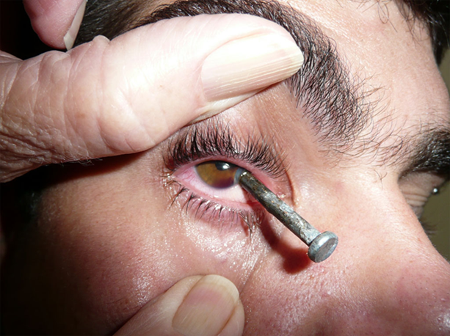
Introduction
Disability instead of mortality
Classifications
Blunt
Penetrating
Burn
Concurrent injuries
Head, face, neck
Other Eye Emergencies
From EyeWorld. http://www.eyeworld.org/images/New_Articles/2009/11/25_b.jpg
Notes:
Ocular trauma is not usually associated with increased mortality; however, this type of trauma can result in disability and be life-altering
Ocular trauma is classified as blunt, penetrating or burn
Concurrent injuries to the head, face, and neck are common in ocular trauma
The primary survey is the priority and is quickly completed before evaluation of ocular injuries. The secondary survey begins with H for history

Slide 3
Ocular Assessment
Clinical exam
External structures
Visual acuity exam
Remove contact lens
Extraocular movements
Pupil exam–PERRL
Reevaluation adjunct exams
Slit lamp exam
Fluorescein examination
Ophthalmoscope examination
IOP (10–20 mm Hg)
Contraindicated if suspect globe rupture or penetrating trauma
Notes:
External structures
Assess the symmetry of the head, face, orbits, and eyelids. Palpate orbits for tenderness or step-offs.
Inspect for lacerations, abrasions, contusions, swelling, and the presence of foreign material
Evert the upper eyelid and inspect for any foreign body. Do not force the eye open if penetrating trauma is suspected.
Visual Acuity Exam
Regardless of the severity of injury, the patient requires a visual acuity exam
Ask the patient to describe his or her vision (blurry, decreased, or normal)
Use a Snellen chart to assess visual acuity (Table 10-2)
After the visual acuity exam, remove the contact lenses (Figs. 10-10 and 10-11)
Extraocular movements (Fig. 10-5)
Ask the patient to follow an object, finger, or light with his or her eyes without moving the head. Conditions that may affect the patient’s ability to perform the EOM evaluation include:
Cranial nerve disruption
Extraocular muscle entrapment
Increased intraocular pressure
Assess pupils for size, shape, symmetry, and reactivity with a light in a darkened room.
The slit lamp examination (Fig. 10-6) is contraindicated in patients who cannot sit upright or if a globe rupture is suspected.
Fluorescein is a staining agent used to determine if there are defects to the cornea of the eye, such as lacerations, abrasions and foreign bodies.
The ophthalmoscope is used to look at the fundus, optic nerve, disc, and the major blood vessels. If possible, dim the lights to allow the patient’s pupil to dilate.
IOP assessment is routinely performed in patients who have loss of vision or blunt trauma.
Normal pressure readings are between 10 and 20 mm Hg
IOP measurement is contraindicated for patients with suspected globe rupture or penetrating trauma

Slide 4
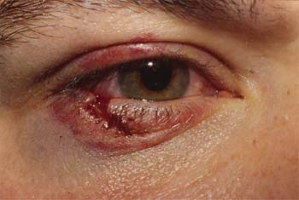
Lid Injury
Inspect for concurrent injuries
Consider consult with eye specialist
Complications may result from improperly closed lid laceration
From Florida Lions Foundation for the Blind. http://www.floridalionsfoundation.org/Eyelid_Injuries.html
Notes:
With any lid injury, it is important to inspect for concurrent injuries such as hyphema, globe rupture, and corneal abrasion.
Complications from an improperly closed lid laceration include:
Ptosis (drooping eyelid)
Notched lid margins
Trichiasis (misdirected eyelashes)
Lagophthalmos (incomplete eye closure)
Corneal exposure
NOTE: Lower eyelid laceration

Slide 5
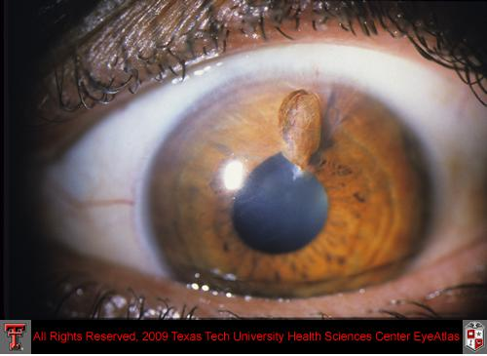
Corneal Abrasions and Lacerations
Assessment findings
Photophobia
Tearing
Pain
Lid swelling
Foreign body sensation
Decreased vision with laceration
Treatment
Ophthalmic drops/solutions
Oral analgesics
From Texas Tech University Health Sciences Center. http://www.ttuhsc.edu/som/ophthalmology/eyeatlas/Cornea/Corneal%20laceration/Corneal_laceration_with_uveal_prolapse,_iris_corectopia,_and_traumatic_cataract.aspx
Notes:
A corneal abrasion is damage to the corneal epithelium. They can be caused by objects such as contact lenses and fingernails.
A corneal laceration is a full thickness injury to the corneal lens with pain out of proportion to the findings.
Assessment findings include:
Photophobia
Tearing
Pain
Lid swelling
Sensation of having a foreign body in the eye
Decreased vision with a laceration
Treatment includes:
Topical ophthalmic antibiotics
Cycloplegic ophthalmic agents to decrease spasms and pain
Oral analgesics
Follow-up with ophthalmologist
Patching not recommended
NOTE: Corneal laceration

Slide 6
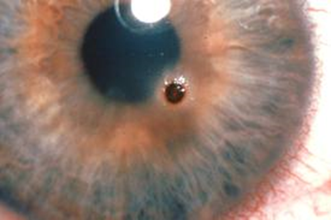
Corneal Foreign Bodies
Assess for
High-speed MOI
Penetration of the globe
Assessment findings
Photophobia, tearing and pain
Treatment
Topical anesthesia and removal
From Stevens, S. (2005). How to remove a corneal foreign body. Community Eye Health Journal, 18(55), 110.
Notes:
Corneal foreign bodies routinely consist of metal, plastic, or wood. They are usually superficial and can be easily removed. Assess for the potential of a high-speed foreign body, which can penetrate the globe.
Assessment findings include:
Photophobia and tearing
Pain
Penetrated globe/conjunctiva
Lid swelling
Treatment includes:
Topical anesthesia
Removal of foreign body
Irrigation: Check the pH of the eye, and instill ophthalmic anesthetic drops
Use warmed normal saline or Ringer’s lactate solution
A Morgan lens or intravenous tubing may be used. Keep in mind that the shorter the tubing, the greater the flow, and pressure and the pain
Direct the stream across the eye from the inner to the outer canthus of the eye
Irrigation is continued until the pH reaches neutral (7.0–7.3)
If irrigation unsuccessful, use a 25-gauge sterile needle. If it is metal, use an eye spud
Ophthalmic antibiotics and systemic analgesia

Slide 7
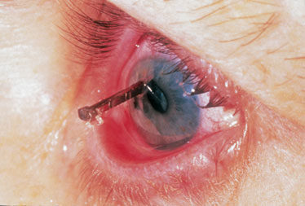
Intraocular Foreign Body
Considered a true ocular emergency
Misshapen pupils
Treatment:
Elevate HOB
Immobilize the foreign body
Protect/shield eye
Ophthalmology consult
Surgery to close globe
From Ho, T. T., & Maccumber, M. W. (2006). Update of posterior segment emergencies. Retrieved from http://www.retinalphysician.com/articleviewer.aspx?articleid=100240
Notes:
An intraocular foreign body is considered a true eye emergency, and early intervention is essential.
Assessment findings include:
Compromised visual acuity
Pain
Pupil maybe misshapen
Treatment includes:
Ophthalmology consult
Perform globe closure as soon as possible
Immobilize the foreign body until it can be removed in surgery
Elevate the head of the bed
Administer systemic and topical ophthalmic antibiotics
Administer systemic analgesics
Avoid applying pressure to the globe, and use a protective shield or fluff dressings

Slide 8
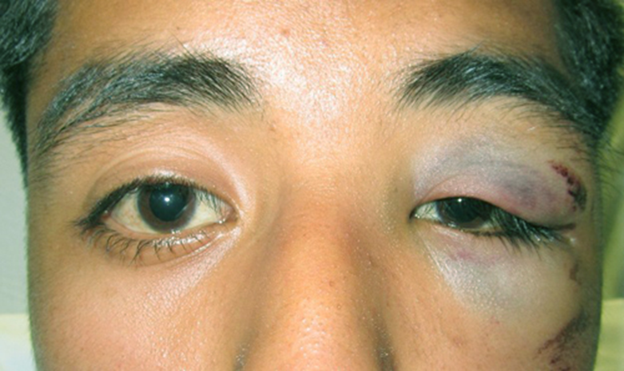
Orbital Fracture
Assessment findings
Periorbital ecchymosis
Diplopia with upward gaze
Enophthalmos
Infraorbital numbness
Treatment
Cool compresses
Do not blow nose
Ophthalmology consult
Surgery
From Christopher Zoumalan, MD. http://www.bheyelids.com/orbitalfractures.asp
Notes:
A direct blow to the eye can result in an orbital fracture. A fracture along the medial or the floor of the orbit is called a blowout fracture. It can cause entrapment of the muscles.
Assessment findings include:
Periorbital ecchymosis
Diploplia
Enophthalmos (sunken eyeball)
Infraorbital numbness
Treatment includes:
Oral antibiotics
Cool compresses
Ophthalmologic consultation with possible surgical repair
Discharge instruction including advising the patient to avoid blowing the nose, sneezing, and/or performing a Valsalva maneuver (bearing down)

Slide 9
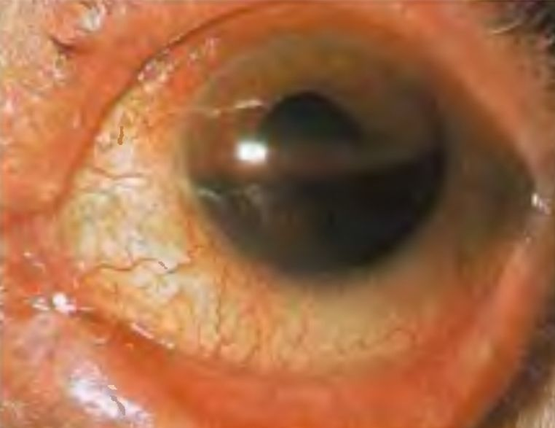
Hyphema
Assessment findings
Pain
Collection of blood
Photophobia
Blurred vision
Increased IOP
Treatment
Admit if > 30% hyphema
Elevate HOB
Avoid NSAIDs and ASA
From Rakesh Ahuja, MD. http://en.wikipedia.org/wiki/File:Hyphema_-_occupying_half_of_anterior_chamber_of_eye.jpg
Notes:
Hyphema is a collection of blood in the anterior chamber of the eye It can be spontaneous, or as a result of trauma. Assessment findings include:
Pain
Collection of blood
Photophobia
Blurred vision from blood in the anterior chamber
Table 10-3 describes the hyphema grading system. A grade 4 hyphema can cause extreme pain
Treatment includes:
Admission if the hyphema is > 30%
Elevate the head of the bed 30 degrees if the cervical spine is cleared
Protect the eye with a metal shield
Pain management
Avoid aspirin and NSAIDs as they will increase the risk for rebleeding, which is greatest 3 to 5 days post injury
Topical ophthalmic beta-blockers are recommended for patients who have an elevated IOP

Slide 10
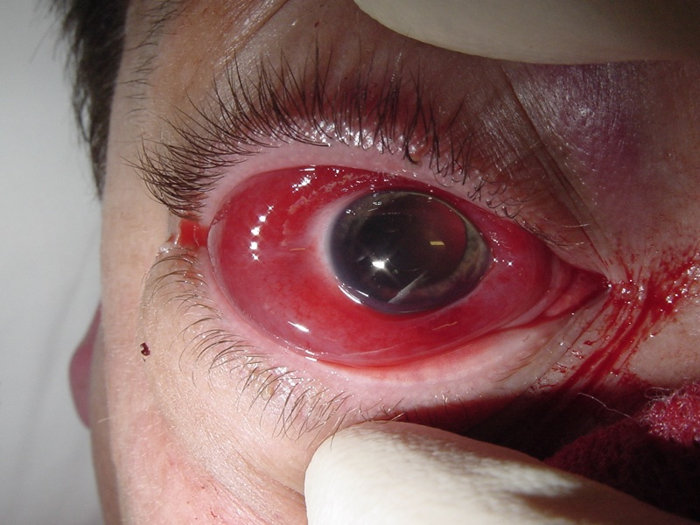
Retrobulbar Hematoma
Assessment findings
Severe pain
Decreased vision
Reduced eye movement
IOP > 40 mm Hg
Emergency decompression
From Nickson, C. (2010). Bashed, blind and bulging. Retrieved from http://lifeinthefastlane.com/2010/09/ophthalmology-befuddler-033-2/
Notes:
A retrobulbar hematoma is hemorrhage into the retrobulbar space and is a rare occurrence.
Bleeding causes increased pressure behind the globe, which causes an elevation in IOP which, in turn, compresses the optic nerve and blood vessels. This is a true ophthalmologic emergency.
Assessment findings include:
Severe pain
Decreased vision
Reduced eye movement
IOP > 40 mm Hg
Treatment consists of emergency decompression for IOP > 40 mm Hg.

Slide 11
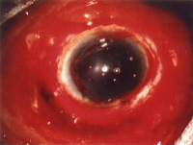
Globe Rupture
Assessment findings
Flat anterior chamber
Extruded eye contents
Hyphema
Irregular-shaped pupil
Periorbital ecchymosis
Severe subconjunctival hemorrhage
Treatment: Protect the eye/repair the globe
From Acerra, J. R., & Golden, D. J. (2012, July 30). Globe rupture. Retrieved from http://emedicine.medscape.com/article/798223-overview
Notes:
A globe rupture is considered a genuine emergency. Assessment findings include:
Flat or shallow anterior chamber
Extruded eye contents
Hyphema
Irregular or tear-drop shaped pupil
Periorbital ecchymosis
Subconjunctival hemorrhage
Decreased visual acuity and extraocular movement
Nausea
Pain that may be difficult to assess depending on patient condition and MOI
Treatment includes:
Avoidance pressure on the globe—do not perform tonometry
Protection of the eye with a rigid shield
Administration of antiemetics to decrease the risk for vomiting, which increases IOP
Avoiding the use of ophthalmic drops or medications
Referral to ophthalmology

Slide 12
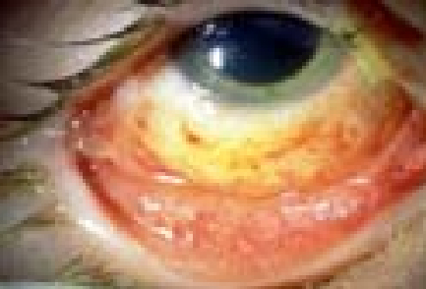
Ocular Burns
True emergency
Alkali: causes liquefaction necrosis (deep)
Acid: coagulation necrosis, forms barrier to deeper penetration
Determine baseline pH
Antibiotics and tetracaine
Irrigate until pH returns to normal range (7.0–7.3)
From Pacific University Oregon. http://www.pacificu.edu/optometry/ce/courses/21042/primarycaretraumapg2.cfm
Notes:
Ocular burns can be the result of chemical, thermal, or radiant source. Chemical burns are considered a true emergency.
Saving the eyesight requires immediate irrigation of the eye
It takes precedence over completion of a history and thorough assessment
Alkali products cause liquefaction necrosis and produce burns that are deeper than acid burns
Acidic burns are less severe, causing immediate damage through coagulation necrosis, which ultimately forms a barrier to deeper penetration
Assessment findings include:
Chemosis (swelling of the sclera)
Conjunctival irritation
Corneal clouding (opacification of the cornea indicates a severe burn)
Pain
Treatment and reevaluation includes:
Baseline pH
Ophthalmic antibiotics and cycloplegics/tetracaine drops for pain
Irrigate the area until pH returns to normal range (7.0–7.3); depending on exposure severity, alkaline burns may require at least 2 L of irrigation
Visual acuity reassessment

Slide 13
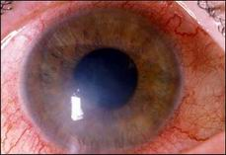
Ultraviolet Keratitis
Assessment findings
Severe pain and photophobia
Conjunctival irritation and tearing
Decreased visual acuity
Treatment
Topical ophthalmic antibiotics
Cycloplegics
Oral analgesics
From The Eye Care Company. http://www.theeyecarecompany.com.au/photokeratitis.html
Notes:
Ultraviolet keratitis, a radiation burn also known as welder’s burn or snow blindness, occurs when ultraviolet lights absorbed by the cornea cause damage to corneal epithelial cells.
This damage produces keratitis, conjunctivitis, or both. Effects are usually cumulative, and it may take up to two days before the patient experiences symptoms
Assessment findings include:
Severe pain and photophobia
Conjunctival irritation and tearing
Decreased visual acuity
Treatment includes:
Topical ophthalmic antibiotics
Cycloplegics
Oral analgesics

Slide 14
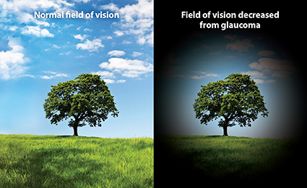
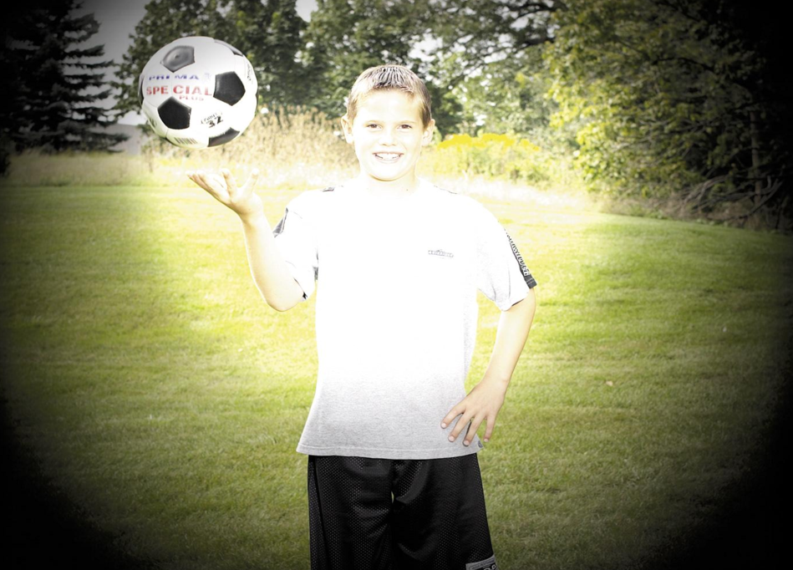
Glaucoma (Open vs. Narrow)
Gradual onset
Narrowing of vision over time
Serious Emergency
Sudden onset
Halos around lights
Severe pain
Nausea & Vomiting

Slide 15

Retinal Detachment
Serious Emergency
Sudden onset
Shadows in peripheral vision
Floaters (spots) or flashes of light in visual fields

Slide 16
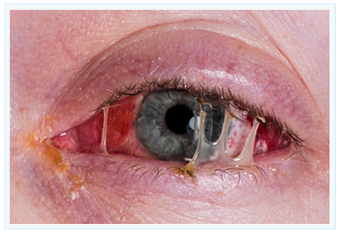
Conjunctivitis
Viral
Bacterial
Chemical
Allergic

Slide 17
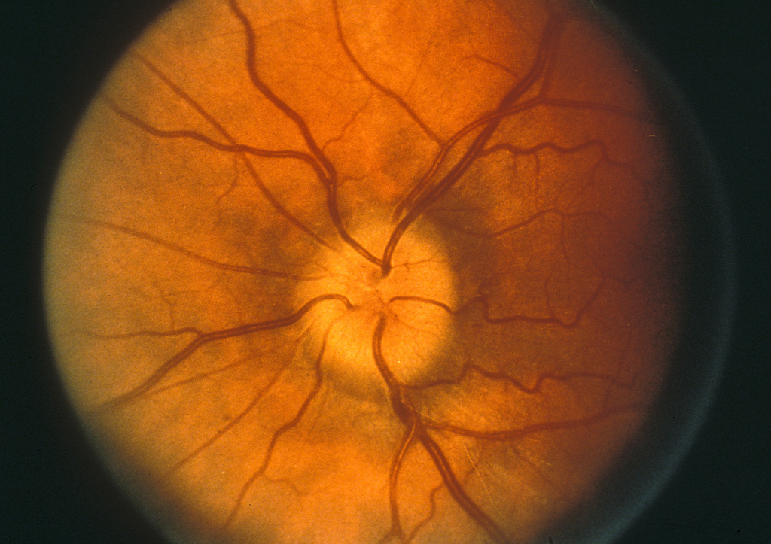
Summary
Life-altering injuries
True emergencies include ocular burns, globe rupture, retrobulbar hematoma, narrow angle glaucoma and retinal detachment.
Notes:
Ocular injuries may not be life-threatening, but they can be vision threatening and life altering.
Thus, it is important to obtain a complete history, perform an immediate assessment, and intervene in a timely manner to save the patient’s sight.
True emergencies include ocular burns, globe rupture, and retrobulbar hematoma.

